Slide 1
MATHEMATICS
CALCULUS

Slide 2
JEE
Applications of Definite Integration
---------
Area under the curve

Slide 3
Area between the curves

Slide 4
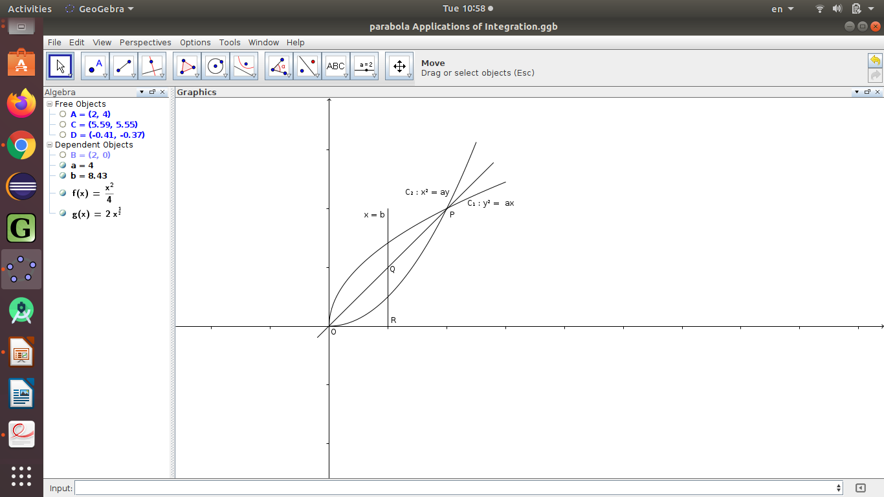
Area under the curve

Slide 6
##### DONE #####

Slide 7
T H A N K Y O U

Slide 8
This is a presentation in
LI BRE OFFICE – IMPRESS
By
Mr. Prahlad Chippalagtti.

